Slide 1
Feature 1
Christopher Mendoza
Gabriel Braun
Haricharan Mukthineni

Slide 2
Introduction
Our project is a C++ application which lets users order food from multiple restaurants.
Project Feature 1 includes letting the user view available restaurants and filtering them based on the cuisine they want.

Slide 3
Feature 1 Overview:
Our main menu lets the user input whether they are ready to order or to exit the application
If the user is ready to order they are then taken to a submenu which allows them to input the type of cuisine or to view all of the restaurants.
Depending on the user input, the application will retrieve the restaurant names and address from the database and print them on the terminal for the user to see.

Slide 4
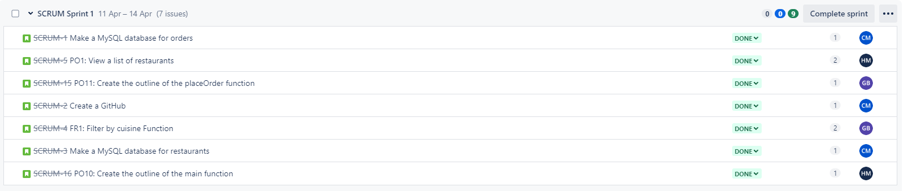
Sprint for Feature 1

Slide 5
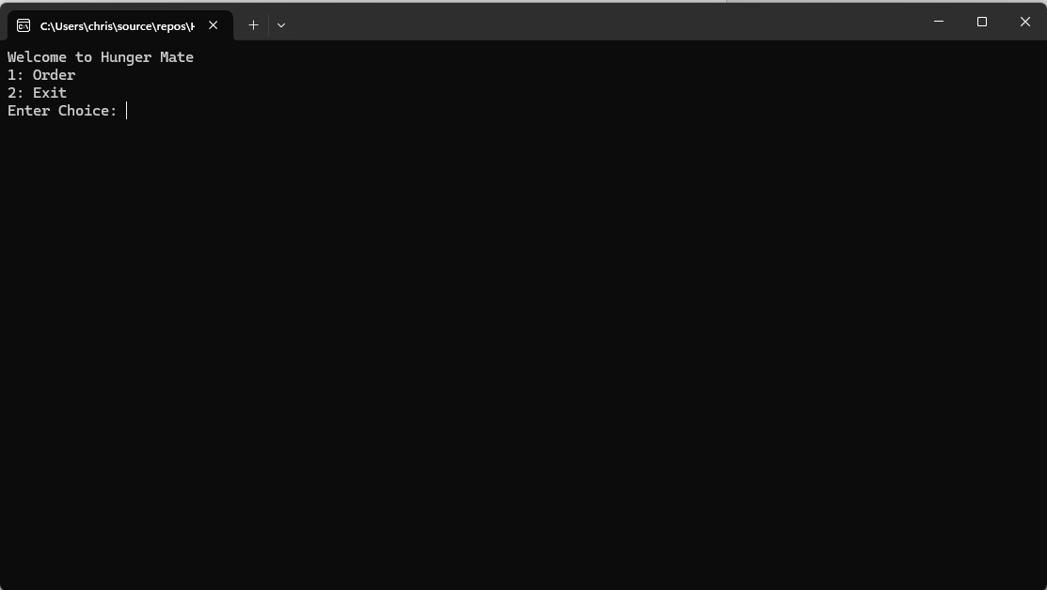
Hunger Mate Main Menu

Slide 6
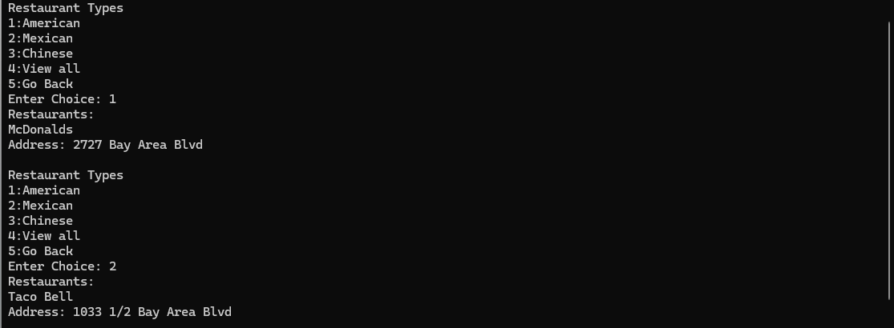
Hunger Mate Filter Menu

